Slide 1
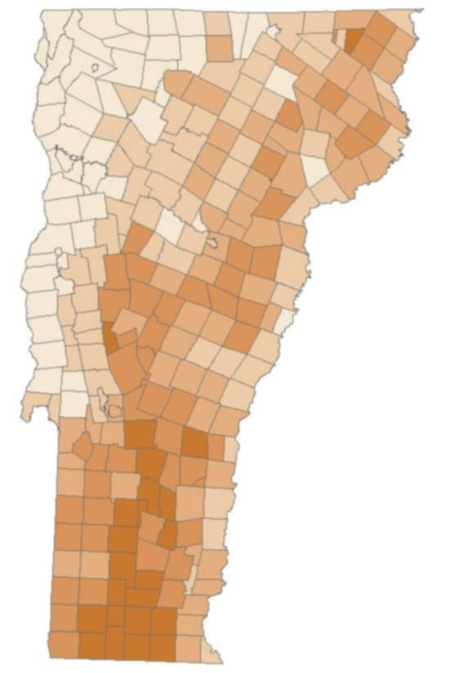

Solarizing Vermont!
Helping communities to meet Vermont’s 2050 renewable goals!
A web app developed by Team Stone for HackVT 2014

Slide 2
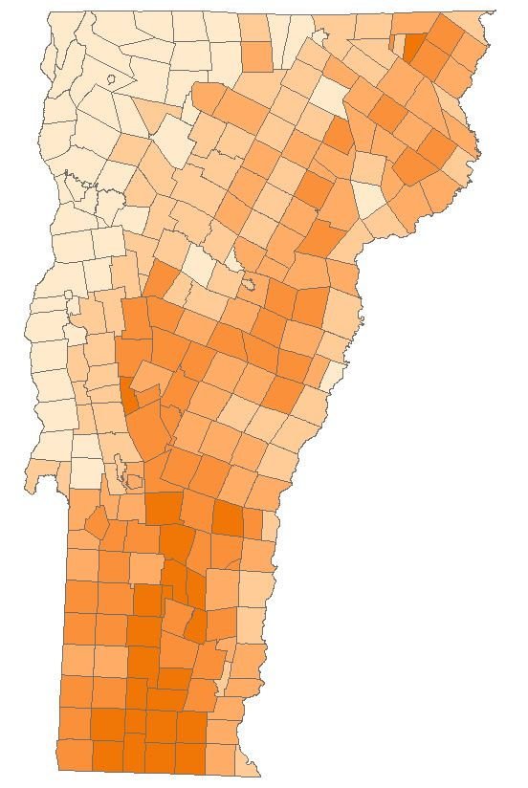
What is Solarizing Vermont?
Solarizing Vermont is an interactive educational tool
Solarizing Vermont Enables Vermont’s Citizens and Students participate in Understanding the Challenge and Possibilities of Achieving Vermont’s 2050 90% Renewable Energy Goal by building their own solar installations in their community.
Solarizing Vermont helps to build community support to reach goal by challenging and empowering the user to meet their community’s solar potential by drawing solar arrays where everthey want to within town and compare against a target.
Measuring progress against a goal is important.
Meet State Energy Goals: Creating a cleaner energy future with goals to shift towards 90% renewables and a 50% reduction in energy usage by 2050.
Notes:
Solarizing Vermont is an interactive educational tool
Solarizing Vermont Enables Vermont’s Citizens and Students participate in Understanding the Challenge and Possibilities of Achieving Vermont’s 2050 90% Renewable Energy Goal by building their own solar installations in their community.
Solarizing Vermont helps to build community support to reach goal by challenging and empowering the user to meet their community’s solar potential by drawing solar arrays where everthey want to within town and compare against a target.
Measuring progress against a goal is important.
Meet State Energy Goals: Creating a cleaner energy future with goals to shift towards 90% renewables and a 50% reduction in energy usage by 2050.

Slide 3
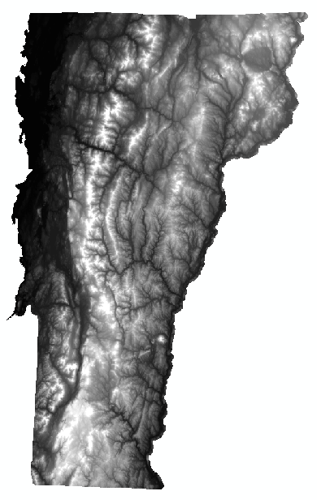
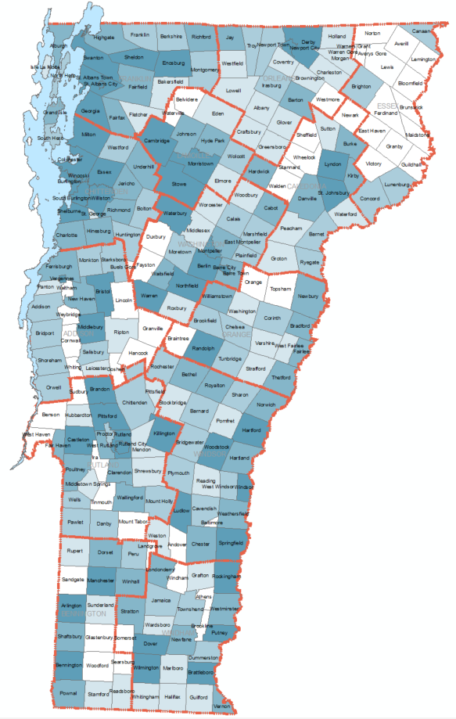
Data Used
Solarizing Vermont Uses current data and current landscape conditions to provide user an interactive experience in locating solar panels in their community.
Data Sources and Challenges: Uses Vermont Community Electricity Usage Data-2011 to understand community base load for 2011-used USGS Geonames database to consolidate Efficiency Vermont 338 community/village into Vermont 255 Communities.
The Ground-mounted Solar Photovoltaic Potential GIS data layer is show in the background of the application.
Notes:
Solarizing Vermont Uses current data and current landscape conditions to provide user an interactive experience in locating solar panels in their community.
Data Sources and Challenges: Uses Vermont Community Electricity Usage Data-2011 to understand community base load for 2011-used USGS Geonames database to consolidate Efficiency Vermont 338 community/village into Vermont 255 Communities.
The Ground-mounted Solar Photovoltaic Potential GIS data layer is show in the background of the application.

Slide 4
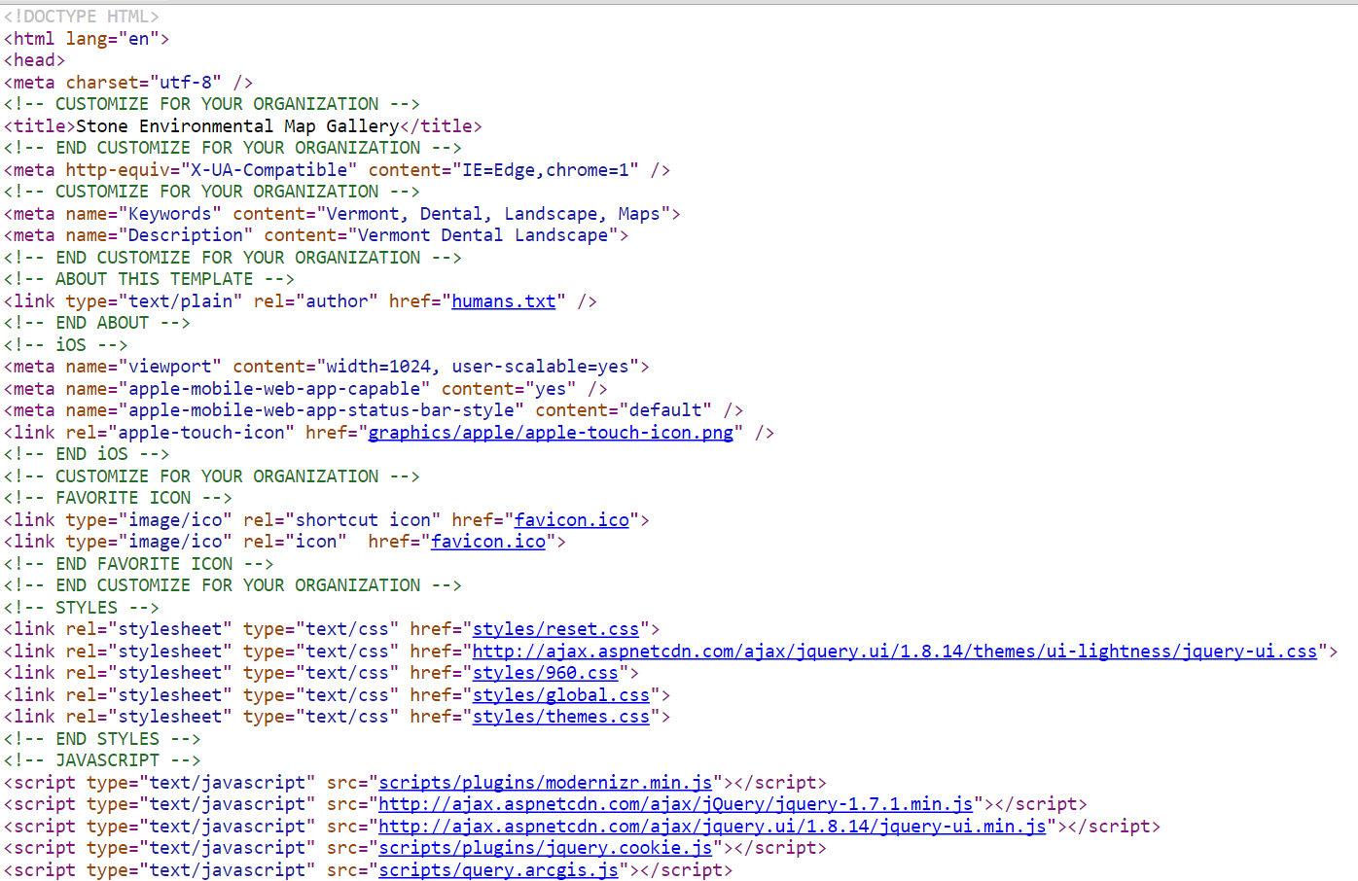
Tools Used
Angular JS
ArcGIS Server
Google Charts
Notes:
Angular JS
ArcGIS Server
Google Charts

